Slide 1
Chapter 13: Public health

Slide 2
Spread of disease
How disease spreads
As the battles of World War I drew to a close, many nations faced another major threat.
The 1918-1919 Spanish influenza outbreak spread rapidly throughout the world, killing up to 100 million people, many more than the war itself.
This outbreak was so devastating because:
it killed healthy, young people along with the frail
populations were exhausted and poorly nourished
transportation of soldiers around the world facilitated disease spread
war had disrupted normal healthcare programs.
Spanish influenza provides a strong example of how factors relating to the host, the pathogen and the environment all contribute to the spread of disease.

Slide 3
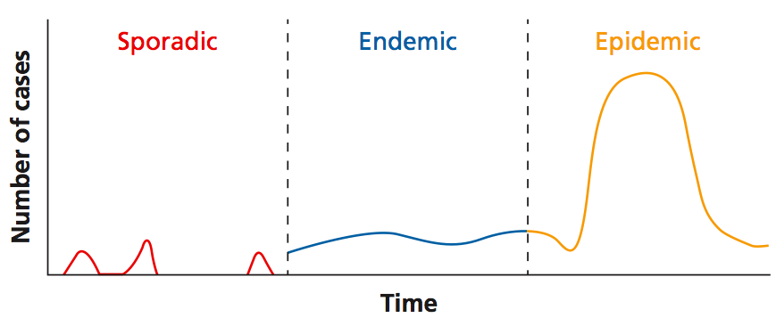
Spread of disease
How disease spreads
The rate of disease transmission is not constant and varies with different diseases, populations and time.
However, there are recognisable patterns of disease transmission.
A sporadic disease is uncommon and occurs irregularly in a population.
Endemic diseases occurs at a relatively constant rate.
Epidemics (also known as outbreaks) occur when there is an increase in the disease rate above what is considered normal.
Figure 13.2
Pandemics are epidemics that spread across continents.

Slide 4
Spread of disease
Factors that affect disease transmission
Understanding the factors that contribute to the spread of disease within a population is an important first step in managing disease outbreaks.
Factors that may affect transmission:
Characteristics of the disease itself e.g. mechanisms of transmission
Environmental factors e.g. climate
Characteristics of the population e.g. levels of immunisation
These factors may be influenced by humans unintentionally, or intentionally as disease control measures.

Slide 5
Spread of disease
Factors that affect disease transmission
Pathogen factors that affect disease transmission
The distribution of a vector
A pathogen’s virulence: its ability to cause severe disease in a host
A pathogen’s infectivity: its ability to spread between hosts
Persistence of a pathogen in asymptomatic carriers
A pathogen’s natural history: the different stages of infection
Persistence of a pathogen within its definitive host or intermediate hosts

Slide 6
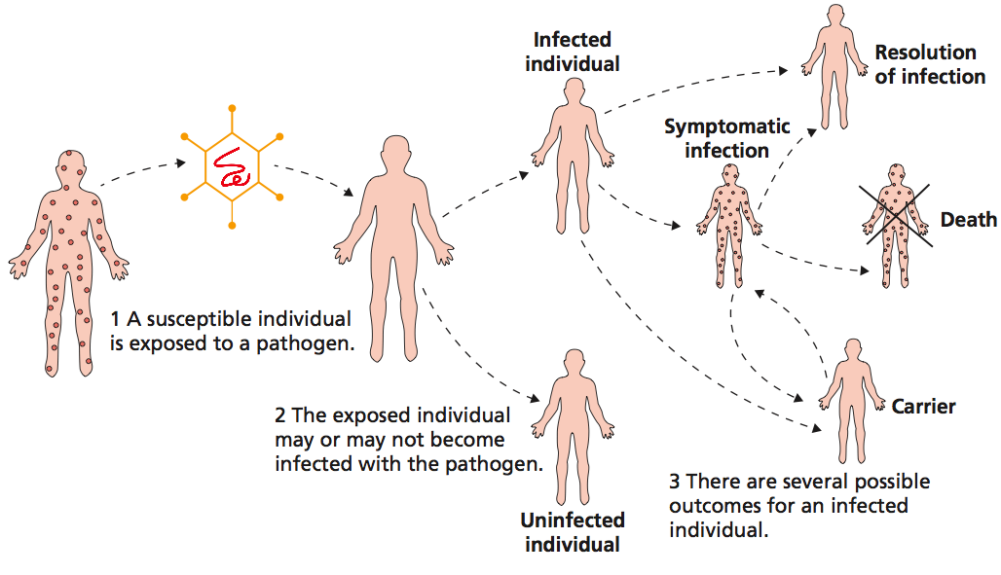
Spread of disease
Factors that affect disease transmission
Exposure to a pathogen can result in several different outcomes.
Figure 13.3

Slide 7
Spread of disease
Factors that affect disease transmission
Environmental factors that affect disease transmission
Climate
Rainfall
Drought
Infrastructure
Temperature
Sewerage systems
Water supply
Extreme events e.g. tsunamis, floods
Roads
Maintaining coordinated treatment programs (e.g. for anti-tubercular medications)
New environmental niches in urban environments (e.g. water tanks for mosquito larvae)

Slide 8
Spread of disease
Factors that affect disease transmission
Environmental factors that affect disease transmission
Example:
Building dams or irrigation networks in malaria-prone regions may promote infection by modifying mosquito breeding areas
This may be through the creation of new breeding sites, modification of the local environment (e.g. humidity) and downstream impacts on the ecosystem.

Slide 9
Spread of disease
Factors that affect disease transmission
Host factors that affect disease transmission
Risk of exposure due to behaviour
Age
Sex
The host’s immune system
Socioeconomic
status
Population density
The proportion of the population with existing immunity to the disease
Movement of individuals

Slide 10
Spread of disease
Factors that affect disease transmission
Movement of individuals can facilitate disease transmission.
Carriers or infected individuals travelling between populations can spread disease.
For example, the arrival of Europeans in Australia was associated with the introduction of several new diseases into populations of Indigenous Australians including:
chicken pox
measles
influenza
typhoid.
These causes significant morbidity and mortality in the Indigenous population.

Slide 11
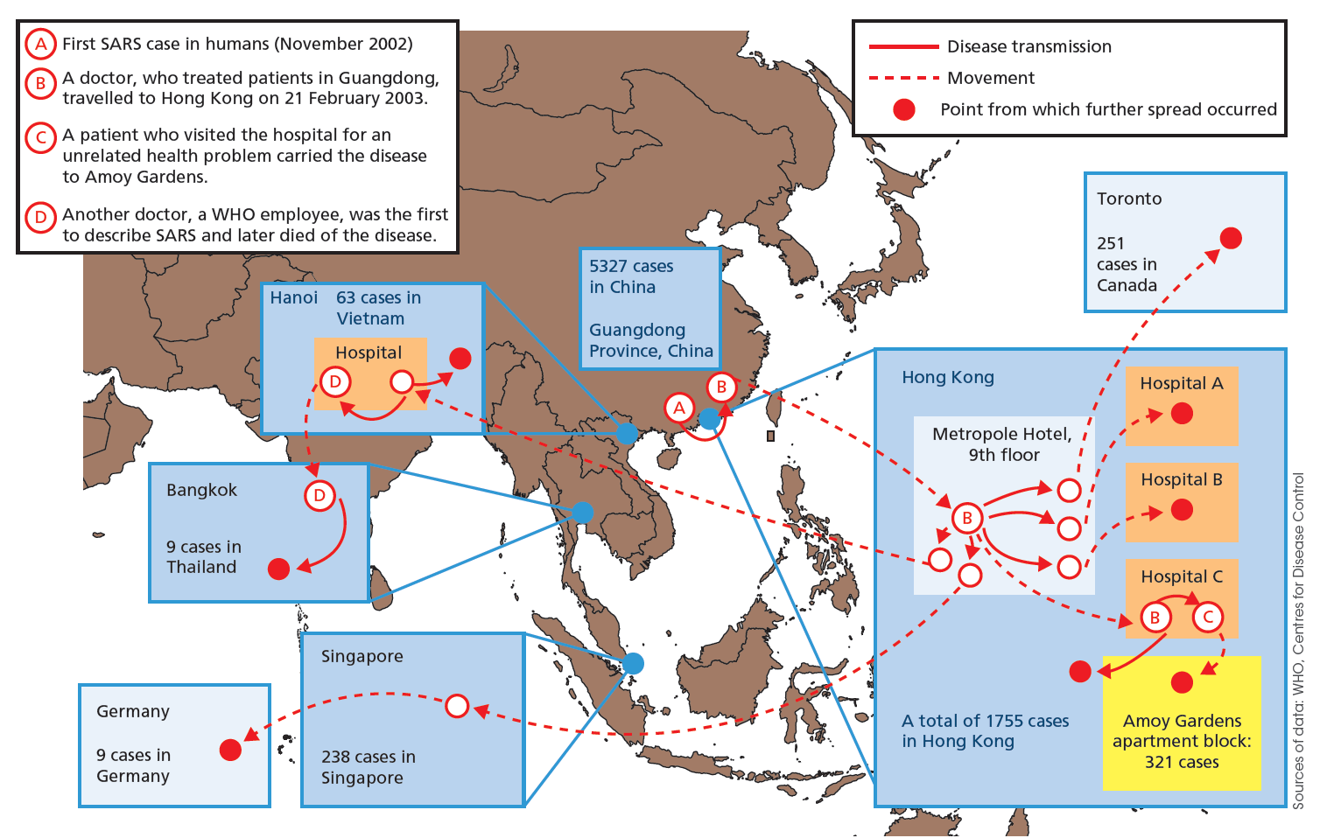
A map of the initial spread of the 2003 SARS epidemic, facilitated by air travel:
Figure 13.7

Slide 12
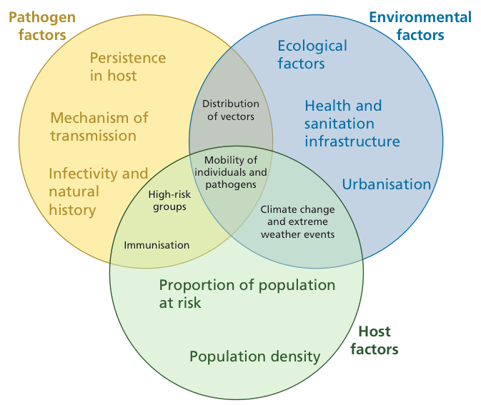
Spread of disease
Factors of disease transmission are interrelated
Figure 13.8

Slide 13
Preventing spread of disease
Scientists who study disease transmission aim to design interventions to halt disease spread.
Some interventions have made an enormous impact:
Hand hygiene Early surgeons did not wash their hands and
contamination of surgeons clothes was
considered a sign of experience
Post-operative death rates were incredibly high
Today, regular handwashing and the use of
sterile equipment are considered key elements
in effective healthcare.

Slide 14
Preventing spread of disease
Scientists who study disease transmission aim to design interventions to halt disease spread.
Some interventions have made an enormous impact:
Immunisation Immunisation has substantially reduced
worldwide morbidity and mortality.
Australian children are routinely vaccinated
against hepatitis B, pertussis, measles, tetanus
and poliomyelitis.
Immunisation programs may help to eradicate
diseases by stopping their spread.

Slide 15
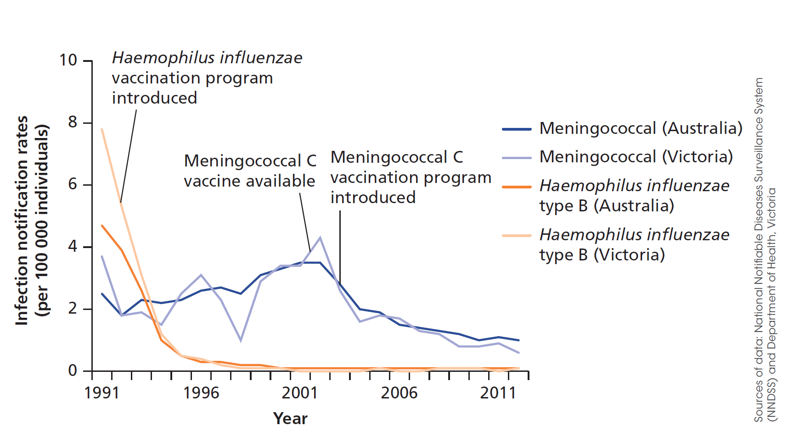
Immunisation
Preventing spread of disease
Rates of Haemophilus influenza type B and meningococcal infection since the introduction of vaccines against these organisms:
Figure 13.10

Slide 16
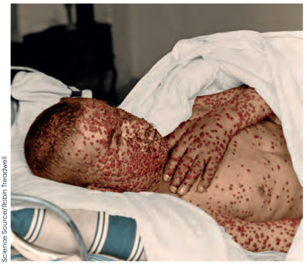
Immunisation
Preventing spread of disease
Smallpox was the first disease to have been declared eradicated through vaccination, in 1980.
Similar attempts to eradicate other diseases, such as polio, have not yet succeeded.
Figure 13.11 A small boy with smallpox

Slide 17
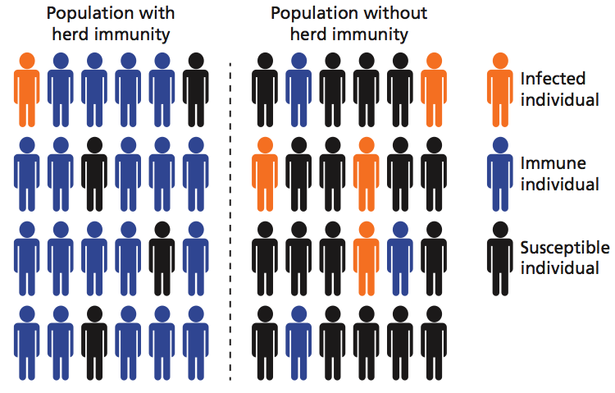
Herd immunity
Preventing spread of disease
Not all members of a population need to be vaccinated for spread of a disease to be prevented.
If a large enough proportion of individuals is immune, there will be too few susceptible individuals to sustain disease spread. This is herd immunity.
Figure 13.12

Slide 18
Herd immunity
Preventing spread of disease
There are some groups who object to immunisation of their children.
The reasons for this vary, but a major concern raised by these groups is the safety of vaccines.
While vaccines can have some side effects, they are usually mild (e.g. pain or swelling at the site).
A small report was released in 1998 suggesting that the measles, mumps and rubella (MMR) vaccine could cause autism. This study was later discredited and its author struck from the UK medical registry for serious professional misconduct.
However, vaccination rates dropped substantially to the point where herd immunity was lost and several outbreaks occurred in the UK in 2013.

Slide 19
Quarantine
Preventing spread of disease
Quarantine is a practice used to stop individuals who have (or may have) been exposed to infectious diseases from carrying that disease into healthy populations.
Exposed individuals are kept from entering a healthy population until the incubation period of that disease has passed, proving they are not infected.
The practice was first used during the fourteenth century to stop the spread of the bubonic plague. Ships arriving into Venetian ports were made to anchor outside the port for forty (quaranta in Italian) days.
Quarantine is also used to prevent the entry of foreign plants, animals and their pathogens into Australia.

Slide 20
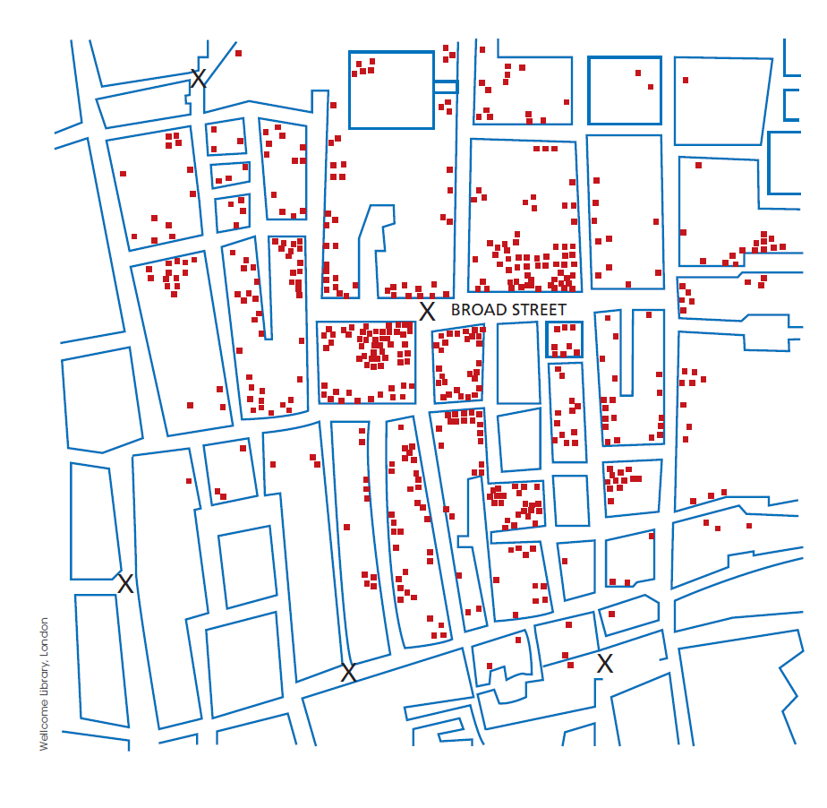
Outbreaks and public health
In 1854, a deadly cholera outbreak struck in London. John Snow, a physician working in London, realised almost all the cases occurred in people who used a single water pump on Broad St.
Importantly, he also showed that people who lived close to the pump and did not contract the disease used different water sources.
Figure 13.15. A reproduction of John Snow’s map showing cases of cholera in relation to the Broad St pump (marked with ‘X’).

Slide 21
Outbreaks and public health
Snow convinced the local authorities to disable the pump, stopping further spread of the disease.
Snow had previously proposed that cholera was spread via contaminated water, which was confirmed 30 years later when the pathogen Vibrio cholerae was discovered.
Snow also identified that the outbreak likely started with a baby whose soiled nappies were washed in water that leaked into the pump’s water supply.
Figure 13.15. A reproduction of John Snow’s map showing cases of cholera in relation to the Broad St pump (marked with ‘X’).

Slide 22
Monitoring disease activity
Outbreaks and public health
To define and control disease outbreaks, public health authorities need to know when and where particular infections are occurring.
In Australia, the list of notifiable diseases contains more than 70 conditions including chicken pox, syphilis, rabies and influenza.
A doctor that diagnoses one of these conditions must report the case to the relevant state health authority. Outbreaks or cases of unusual diseases can then be investigated.
What are the limitations to data collected this way?

Slide 23
Monitoring disease activity
Outbreaks and public health
Not all patients who are infected with a disease will seek health care.
Not all patients will receive a diagnosis.
Infections can be under-reported.
There can be a delay between the onset of symptoms, diagnosis and reporting, limiting the ability of public health authorities to respond quickly to epidemics.
Recently, researchers have been exploring alternative ways of conducting disease surveillance.

Slide 24
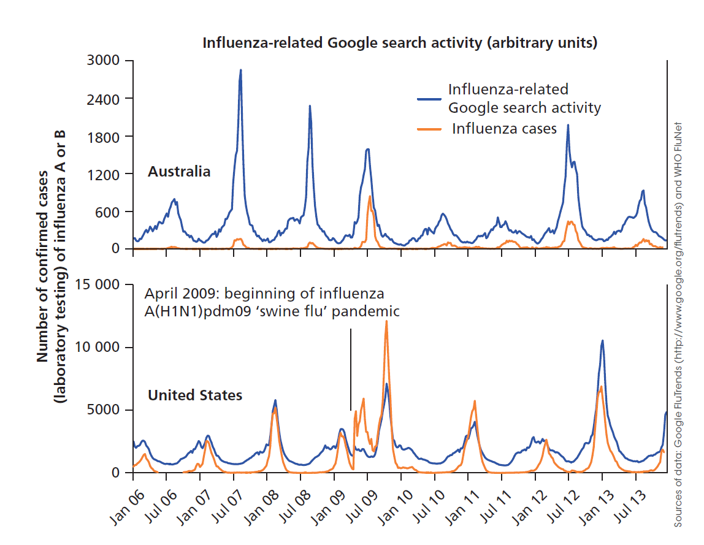
Monitoring disease activity
Outbreaks and public health
The widespread use of the Internet and social media provides a novel data source from which information about the frequency of diseases can be extracted.
Facebook, Twitter and mobile phones have all been used to monitor disease activity.
Figure 13.16
Patterns of influenza infection and Google search activity related to flu-like illness in the US and Australia.

Slide 25
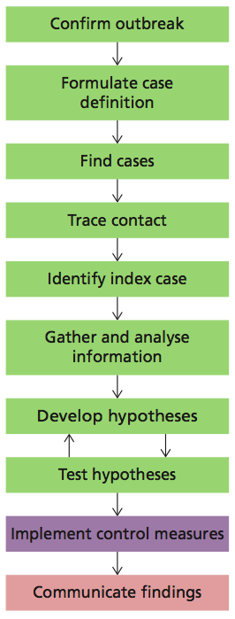
Managing an outbreak
Outbreaks and public health
The first step in managing a disease outbreak is investigating cases to ensure they do meet the definition of an outbreak.
Investigators can then formulate a case definition of which cases are considered part of the outbreak.
These include the type of illness, place and time.
The next steps, finding cases, gathering information and forming hypotheses, are easiest if the mechanism of disease transmission is already known.
Figure 13.17. The steps involved in investigating a disease outbreak.

Slide 26
Managing an outbreak
Outbreaks and public health
Investigators then have to find people affected by the outbreak. Tracking down infected individuals is achieved through contact tracing.
The types of contacts sought will vary with the mechanisms of disease transmission. E.g. sexually transmitted diseases vs. airborne diseases.
As part of case finding, investigators may be able to track down the index case.
In the Soho cholera outbreak, the baby Frances Lewis was the likely index case.
Figure 13.17. The steps involved in investigating a disease outbreak.

Slide 27
Managing an outbreak
Outbreaks and public health
Investigators will then gather information from cases. This usually involves extensive interviews that include questions about usual activities, sick contacts, recent meals and travel.
The aim of these interviews is to generate a hypothesis about how the outbreak is spreading.
Once a hypothesis has been generated the interviewers can search for evidence to support or refute the hypothesis.
This may require further interviews, site inspections and environmental sampling or analysis of collected data.
Figure 13.17. The steps involved in investigating a disease outbreak.

Slide 28
Managing an outbreak
Outbreaks and public health
The finals steps of an outbreak investigation are to implement measures to control the spread and communicate the findings.
These steps may take place while the other steps are ongoing.
Figure 13.17. The steps involved in investigating a disease outbreak.

Slide 29
An example of an outbreak
Outbreaks and public health
In 2007, authorities were alerted to a potential outbreak of gastroenteritis amongst people who had eaten at a particular restaurant in Port Macquarie.
Cases were defined as those ‘who had attended the restaurant for dinner and subsequently developed diarrhoea plus one more additional symptom of gastroenteritis (nausea, vomiting, abdominal pain, fever or lethargy)’
Everyone who dined at the restaurant was contacted and asked about symptoms. Investigators determined that 19 people had contracted gastroenteritis that night.
One of the patients was tested and found to be infected with norovirus, a common cause of gastroenteritis.

Slide 30
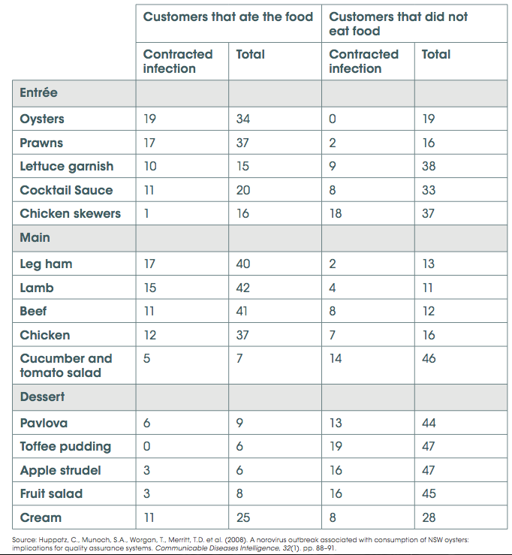
Table 13.2. Study of foods eaten at the restaurant in Port Macquarie showing items eaten by those that did and did not contract gastroenteritis.
19/34 people who ate oysters contracted the infection.
Of those that didn’t contract the infection, none had eaten the oysters.
The outbreak was found to be caused by a batch of oysters contaminated with norovirus.

Slide 31
Predicting the spread of disease
Outbreaks and public health
Mathematical models that can predict the spread of disease are important tools in the control of an outbreak. Such tools can:
be used to explore the likely effects of newly emerging pathogens and changes in environmental conditions
design and predict the effects of potential public health interventions.
To make these predictions, mathematical models include several assumptions about how different variables behave.
The accuracy of these models is dependent on these assumptions being met.
The use of mathematical models to predict disease spread involves close collaboration between mathematicians and biologists.

Slide 32
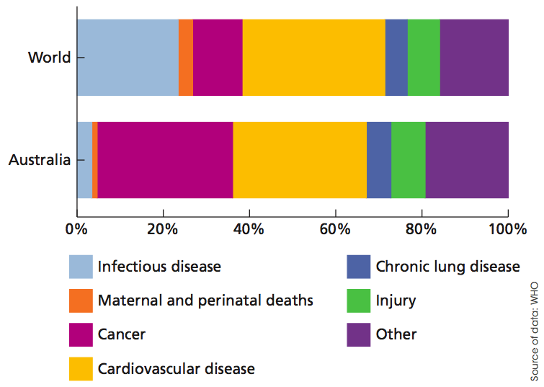
Epidemiology and non-infectious disease
Infectious diseases are a major cause of death worldwide.
In Australia, infectious disease cause a much smaller proportion of deaths in Australia than the world average.
This may be due to:
access to healthcare
good sanitation
clean drinking water
good nutrition.
The principles of epidemiology can also be applied to non-communicable diseases such as cancer or cardiovascular disease, to assess possible causes of disease or test the efficacy of public health interventions.

